Slide 1
The Proxy Design Pattern
Structural Design Patterns in Java

Slide 2
What is the Intent?
Definition: To provide a surrogate or placeholder for another object to control access to it.
The Goal: The Proxy acts as a "Gatekeeper" or "Agent" for the Real Object.
Transparency: The Client interacts with the Proxy as if it were the Real Object, using the same interface.

Slide 3
The Real-World Analogy
The "Credit Card" Analogy
Real Subject: The actual Cash in your bank vault. (Heavy/Protected)
Proxy: The Plastic Credit Card. (Lightweight/Access Control)
How it works: You don't carry $5,000 in cash to the store. You carry the Card. The store "talks" to the Card, and the Card authorizes the bank to release the funds.
R

Slide 4
Key Participants (UML)
Structure and Participants
Subject (Interface): Defines the common methods for both RealSubject and Proxy.
RealSubject: The actual object that performs the core business logic.
Proxy: Maintains a reference to the RealSubject and controls its lifecycle.

Slide 5
Common Variations
Three Flavors of Proxy
Virtual Proxy: Used for "Lazy Loading." It creates expensive objects only when they are actually needed.
Protection Proxy: Used for Security. It checks the caller’s permissions before allowing access to the RealSubject.
Remote Proxy: Used for Networking. It represents an object that exists on a different server or JVM.

Slide 6
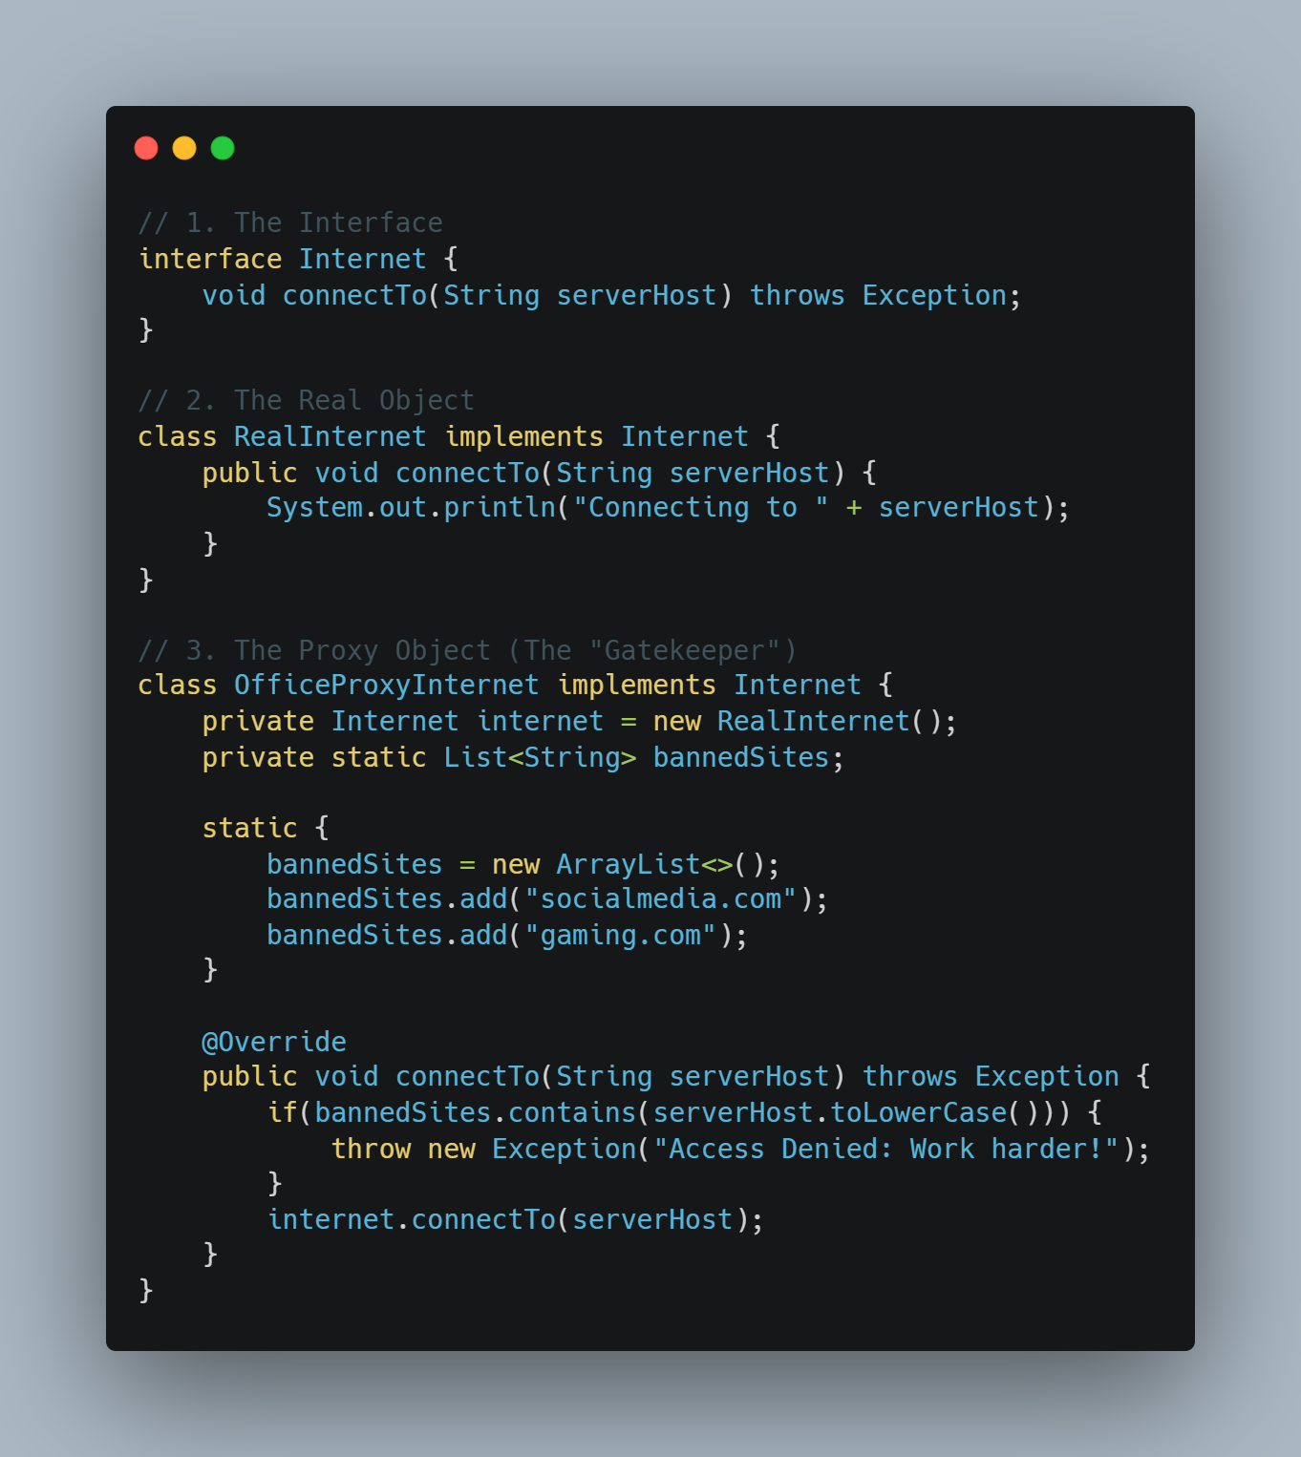
Java Implementation

Slide 7
Why Use It? (The Benefits)
Benefits of the Proxy Pattern
Security: Adds a protective layer without modifying the original code.
Performance: Avoids memory waste by deferring the creation of "heavy" objects.
Single Responsibility: Keeps the RealSubject focused on logic while the Proxy handles "housekeeping" (logging, security, caching).

Slide 8
Proxy vs. Decorator
Key Differences
Proxy Pattern: Focuses on Access Control. It decides IF and WHEN a client can use the object.
Decorator Pattern: Focuses on Adding Behavior. It adds extra features to the object (like adding sugar to coffee).

Slide 9
Conclusion
Summary
The Proxy pattern is a powerful tool for optimization and security.
It promotes the Open/Closed Principle—extending behavior without modifying existing code.
It is a fundamental pattern used in Java Frameworks like Spring (for AOP) and Hibernate (for Lazy Loading).

